Slide 1


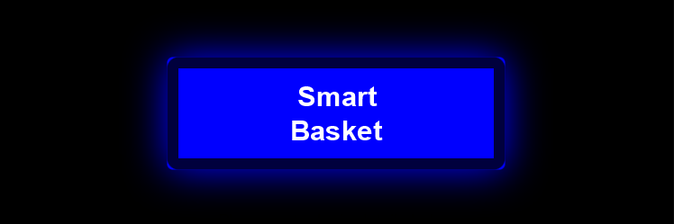
Smartbasket
Billing system based on rfid Student no.: 213240013 full name: Dipolelo methi

Slide 2
Content
Network topology and components
Software overview
Hardware overview
Firmware overview
Workmanship
Conclusion

Slide 3
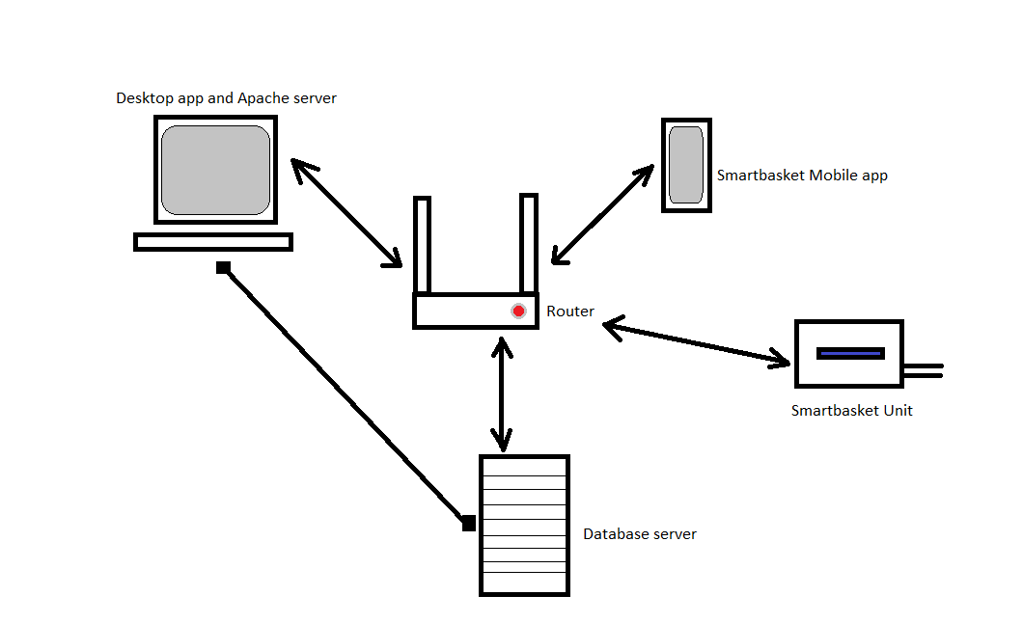
Network topology and COMPONENTS
The system uses a Hybrid network architecture viz. LAN and WAN
Contains the following components:
Router
Smart Basket Unit
Desktop computer
Database server
Mobile phone

Slide 4
Software overview
The system is developed using Git as a tool that facilitates Software Configuration Management (SCM) to ensure versioning of the software.
The Agile framework was used to ensure that components and features of the software were developed in phases.
These components are developed using MVC design pattern to ensure the business logic, UI and database are coded in their separate modules and are easy to manage.
The following development tools were used:
Java SE, the most secure programming language due to its JVM; its source code compiler produces highly portable object code, which makes the software to execute on the majority of operating systems viz. Windows, Linux, Unix, Polaris OS, macOS and etc.
JavaFX, used for designing the UI on both the mobile and desktop applications.
XAMP platform – PHP for server script, MariaDB for SQL
NB: The JRE 11+ should be installed in order to run the desktop application and Android OS v10+ (API 30) for mobile application

Slide 5
Software overview cont…
Software component | Tool | Security
Model (Database) | SQL | MariaDB
View (User Interface) | JavaFX 11.0.2 | Java Virtual Machine (JVM)
Controller (Business logic) | Visual Basic → Java SE 11.0.2 | JVM
Server script (Tunnelling) | PHP 8.0.1 | RESTful API

Slide 6
Hardware overview
The hardware system was designed using the due processes such as:
Planning - the hardware requirements of the system will be organized and thought out
Design and Prototyping - the hardware components of the system were soldered on the breadboard for prototyping.
Development - after prototyping the hardware is soldered and mounted on the Veroboard. The firmware for the microcontrollers is also burnt on the chips.
Testing – the hardware is tested for stability and data consistency. This is to ensure that QA processes where fulfilled.
Deployment – the hardware is then mounted into the container and integrated with the rest of the system.

Slide 7
HARDWARE OVERVIEW CONT…
 | Library | Purpose
Arduino Uno Rev. 3 | - | The Arduino microcontroller is responsible for manipulating data from other hardware components.
Hitachi based LCD display | LiquidCrystal_I2C | The LCD display is responsible for displaying text that is appropriate to the state of the SmartBasket Unit
MFRC522 | MFRC522 | Is responsible for scanning RFID signals and decoding the UID of the tags
SIM900 GSM | GSM_SIM900 | This module is responsible encoding and decoding GSM and GPS signals
ESP8266 | ESP8266WiFi | This module is responsible for connecting to the router in order to send and receive data from the server
LM7805 regulator | - | Is used for maintaining input voltage at 5V
Push buttons (x4) | - | The buttons are used to manipulate the state of the system

Slide 8
FIRMWARE OVERVIEW
The C++ programming language and Arduino IDE. The table below displays the states in which the SmartBasket unit can transition into.
Present State | Next Transition | Trigger
LOGIN | SCANNING | LoginSuccess
SCANNING | SCAN_LOYALY_CARD | CheckoutButton
SCAN_LOYALTY_CARD | READY | BankCardScanned
READY | SCANNING | CheckoutButton

Slide 9
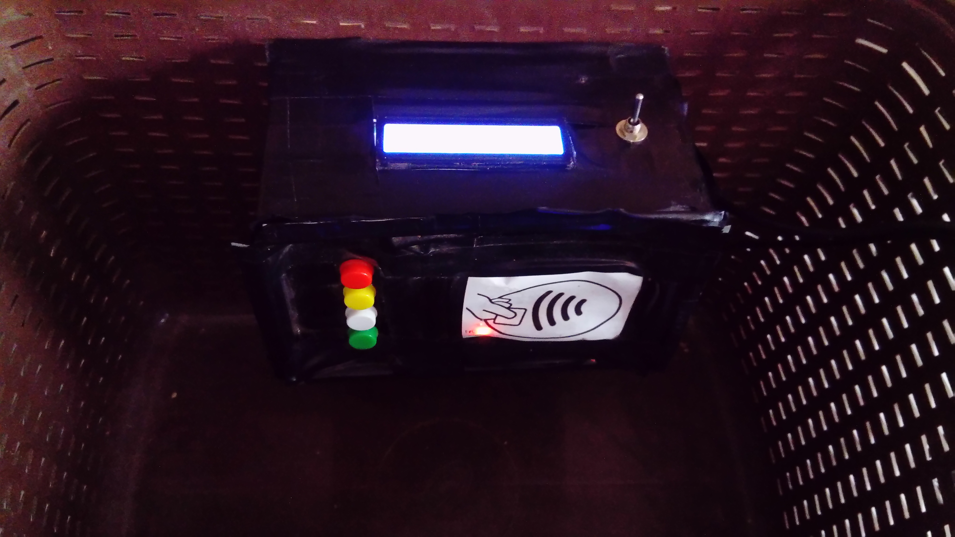
Hardware workmanship

Slide 10
SUMMARY
The system network topology is a hybrid model which uses LAN and WAN. The LAN is a connection between the desktop computer and the Internet Gateway, where as the WAN is a connection method used by the SmartBasket Unit, smartphone, Router and the desktop computer. The software used to process the information was developed using SCM and SQA tools and frameworks to ensure the quality of software is maintained. The hardware development lifecycle was used to design and fabricate the hardware of the SmartBasket Unit.

